Slide 1

COVID CONSPIRACY
USING TWITTER DEVELOPER API
12.08.2020 | FINAL PROJECT | CIS-543 PROGRAM FOR DATA ANALYTICS |
Li Huaikuan, Mariah Bastos, Nicholas Rivera

Slide 2

Agenda
1
Introduction
2
Text Analysis and Sentiment Analysis
3
Decision Trees
4
Logistic Regression
5
Naive Bayes
6
Clustering
7
Non-Linear Regression
8
Conclusion

Slide 3

Coronavírus Conspiracy
Disbelief of COVID in the USA
What contributes for the disbelief?
1
Economic damage may be a "cure worse than the disease"
WHO and CDC information
Conspiracy Theories - desire for understanding and certainty,, desire for control and security and to maintain a positive self-image
American Government
2
3
Narcissistic or self-centered perspective among the young people and health adults.
Chinese Government
Lack of Answers and Experience
Optimism Bias

Slide 4
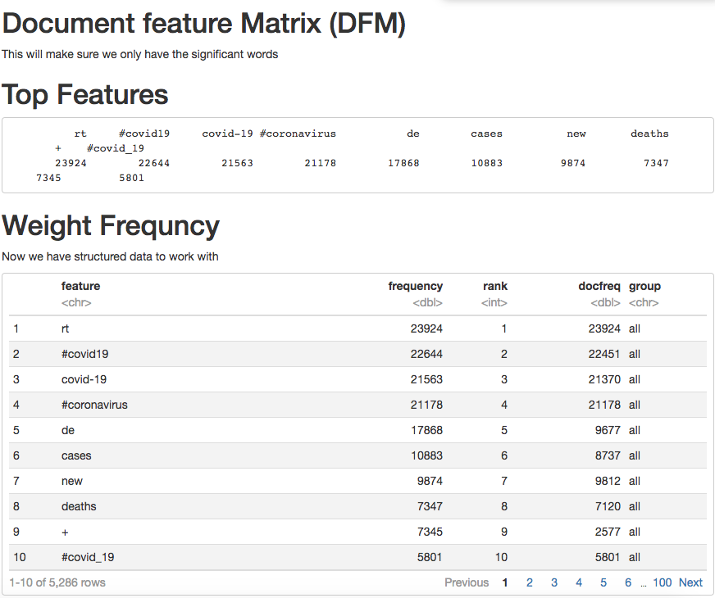
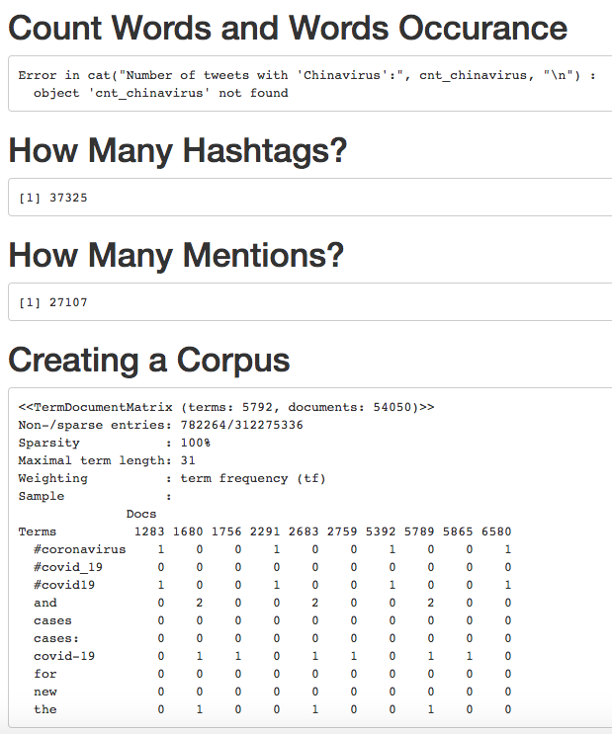
Text Analysis
Notes:
1- WHICH KPIS, HOW DO WE CONNECT THE DATABASE, HOW MANY DATABASES WE HAVE?
2- TRAFFIC, REVENUE, SALES?
3- WEEKLY, MONTHLY?
4- ERP SYSTEMS, GOOGLE ANALYTICS, ONLINE SYSTEMS?
5- AFTER TWO WEEKS, 1 MONTH?
6- POWER BI, TABLEAU, EXCEL?

Slide 5
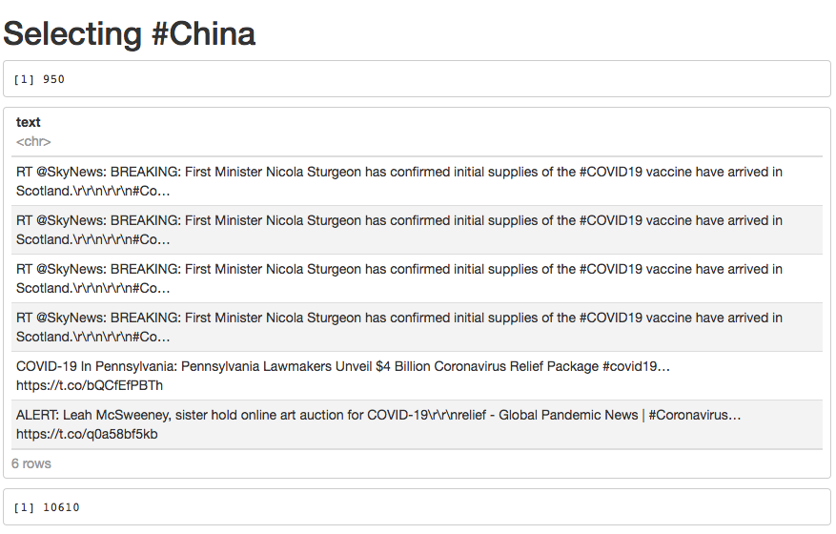
Text Analysis
Notes:
1- WHICH KPIS, HOW DO WE CONNECT THE DATABASE, HOW MANY DATABASES WE HAVE?
2- TRAFFIC, REVENUE, SALES?
3- WEEKLY, MONTHLY?
4- ERP SYSTEMS, GOOGLE ANALYTICS, ONLINE SYSTEMS?
5- AFTER TWO WEEKS, 1 MONTH?
6- POWER BI, TABLEAU, EXCEL?

Slide 6
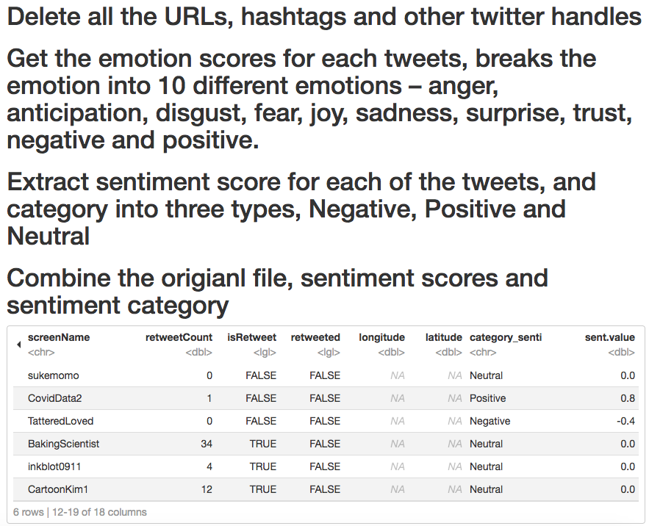

Sentiment Analysis
Notes:
1- WHICH KPIS, HOW DO WE CONNECT THE DATABASE, HOW MANY DATABASES WE HAVE?
2- TRAFFIC, REVENUE, SALES?
3- WEEKLY, MONTHLY?
4- ERP SYSTEMS, GOOGLE ANALYTICS, ONLINE SYSTEMS?
5- AFTER TWO WEEKS, 1 MONTH?
6- POWER BI, TABLEAU, EXCEL?

Slide 7
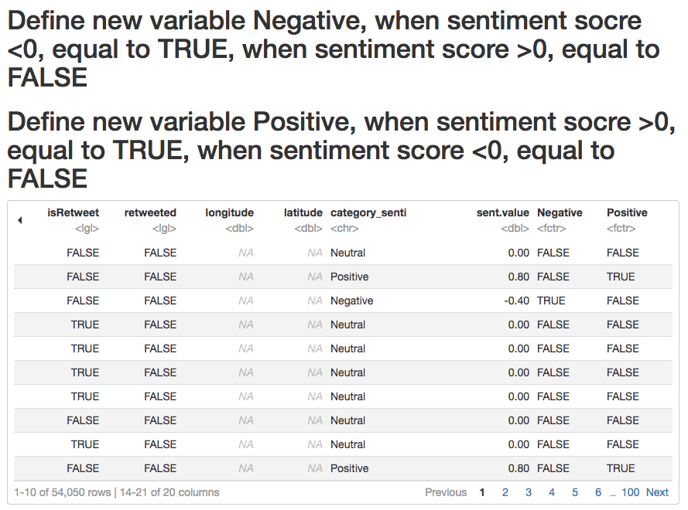
Sentiment Analysis
Notes:
1- WHICH KPIS, HOW DO WE CONNECT THE DATABASE, HOW MANY DATABASES WE HAVE?
2- TRAFFIC, REVENUE, SALES?
3- WEEKLY, MONTHLY?
4- ERP SYSTEMS, GOOGLE ANALYTICS, ONLINE SYSTEMS?
5- AFTER TWO WEEKS, 1 MONTH?
6- POWER BI, TABLEAU, EXCEL?

Slide 8
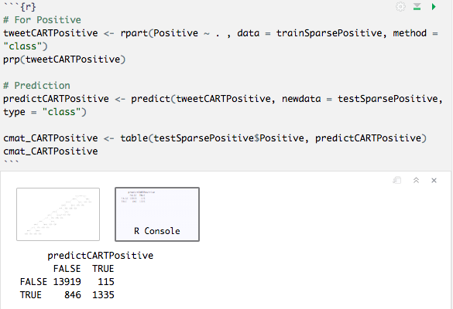
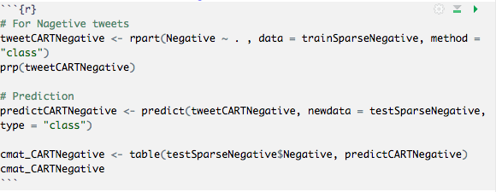
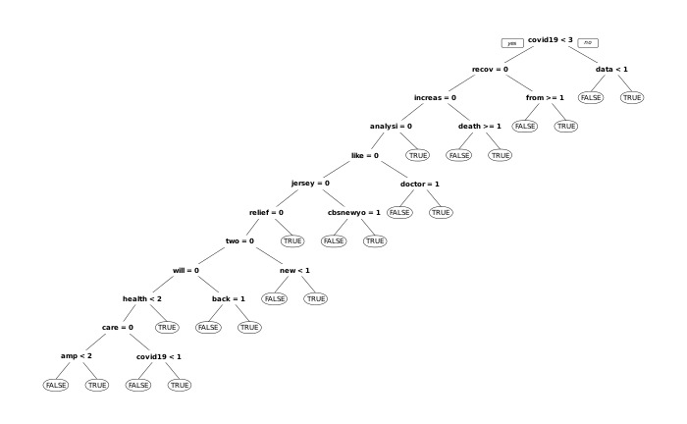
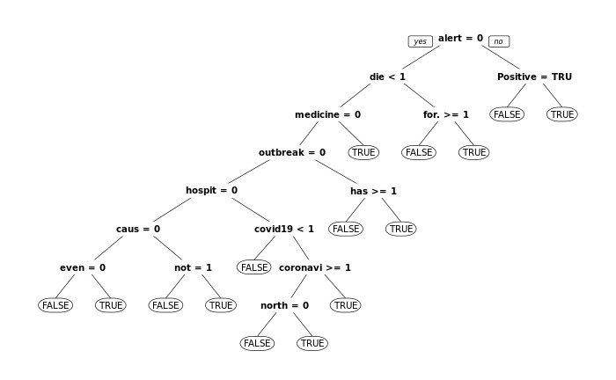
Decision Tree
Positive
Accuracy = 0.941
Recall = 0.612
Precision = 0.921
Negative
Accuracy = 0.938
Recall = 0.477
Precision = 0.823
Notes:
1- WHICH KPIS, HOW DO WE CONNECT THE DATABASE, HOW MANY DATABASES WE HAVE?
2- TRAFFIC, REVENUE, SALES?
3- WEEKLY, MONTHLY?
4- ERP SYSTEMS, GOOGLE ANALYTICS, ONLINE SYSTEMS?
5- AFTER TWO WEEKS, 1 MONTH?
6- POWER BI, TABLEAU, EXCEL?

Slide 9
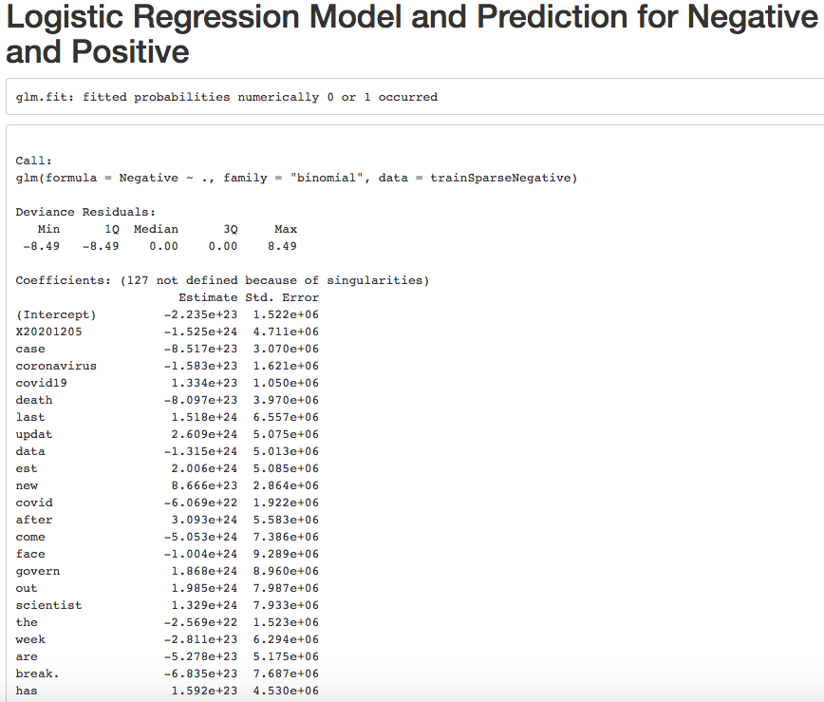
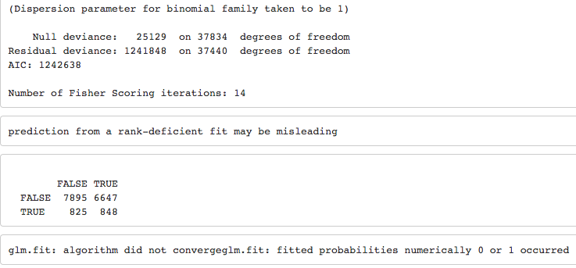
Logistic Regression
Logistic Regression Negative
Accuracy = 0.468
Recall = 0.454
Precision = 0.09
Notes:
1- WHICH KPIS, HOW DO WE CONNECT THE DATABASE, HOW MANY DATABASES WE HAVE?
2- TRAFFIC, REVENUE, SALES?
3- WEEKLY, MONTHLY?
4- ERP SYSTEMS, GOOGLE ANALYTICS, ONLINE SYSTEMS?
5- AFTER TWO WEEKS, 1 MONTH?
6- POWER BI, TABLEAU, EXCEL?

Slide 10
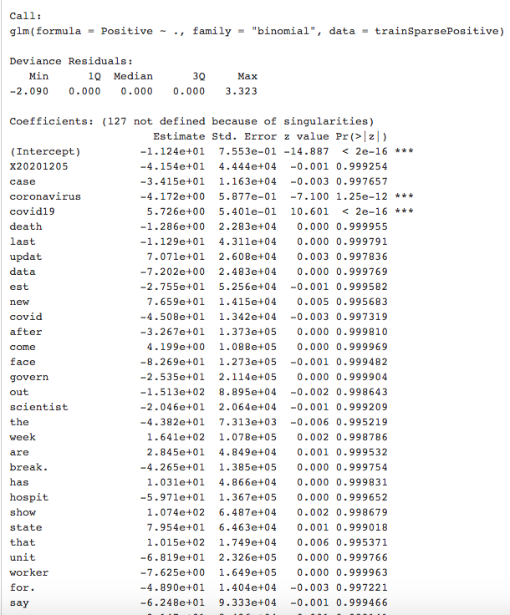
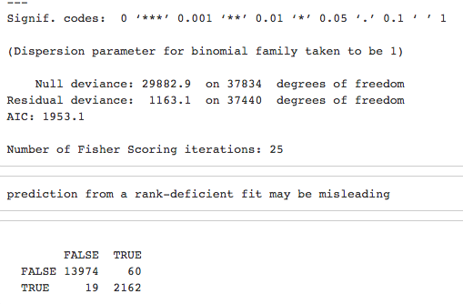
Logistic Regression
Logistic Regression Positive
Accuracy = 0.995
Recall = 0.991
Precision = 0.979
Notes:
1- WHICH KPIS, HOW DO WE CONNECT THE DATABASE, HOW MANY DATABASES WE HAVE?
2- TRAFFIC, REVENUE, SALES?
3- WEEKLY, MONTHLY?
4- ERP SYSTEMS, GOOGLE ANALYTICS, ONLINE SYSTEMS?
5- AFTER TWO WEEKS, 1 MONTH?
6- POWER BI, TABLEAU, EXCEL?

Slide 11
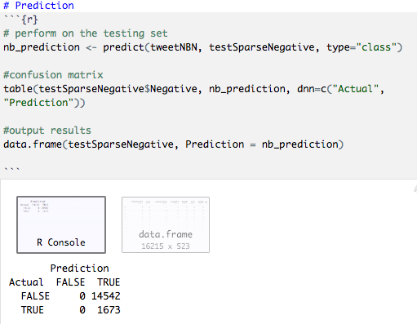
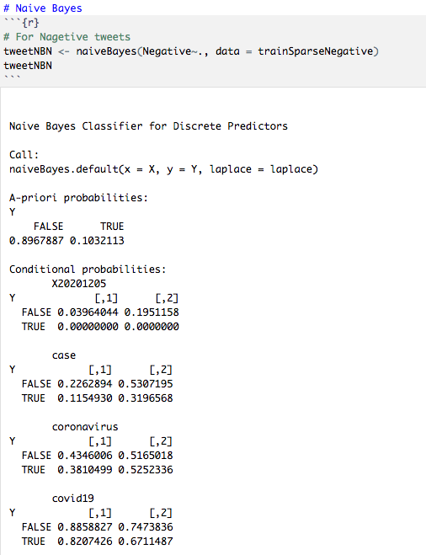
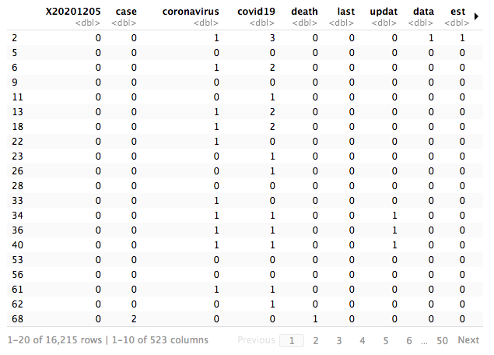
Naive Bayes
Naive Bayes Negative
Accuracy = 0.103
Recall = 1
Precision = 0.103
Notes:
1- WHICH KPIS, HOW DO WE CONNECT THE DATABASE, HOW MANY DATABASES WE HAVE?
2- TRAFFIC, REVENUE, SALES?
3- WEEKLY, MONTHLY?
4- ERP SYSTEMS, GOOGLE ANALYTICS, ONLINE SYSTEMS?
5- AFTER TWO WEEKS, 1 MONTH?
6- POWER BI, TABLEAU, EXCEL?

Slide 12

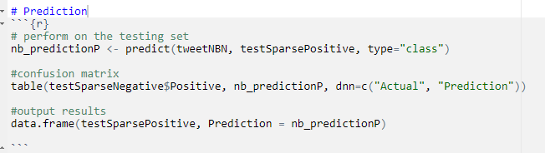
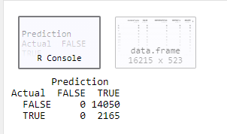
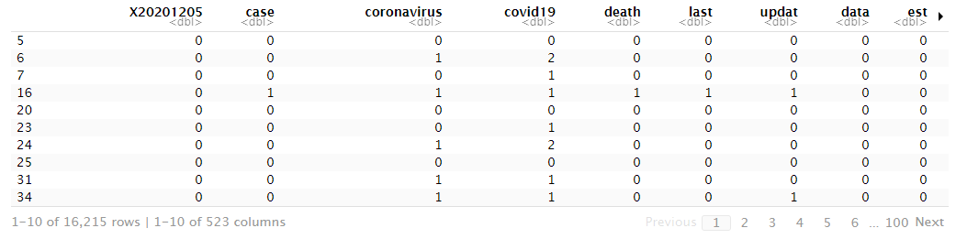
Naive Bayes
Naive Bayes positive
Accuracy = 0.133
Recall = 1
Precision = 0.133

Slide 13
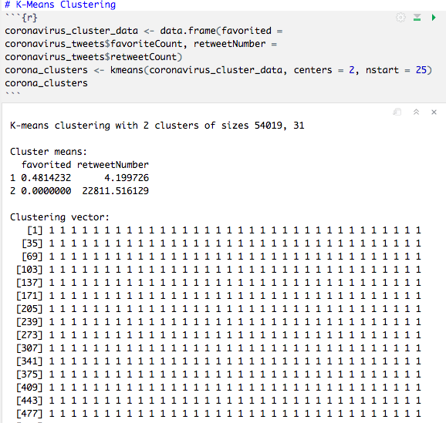
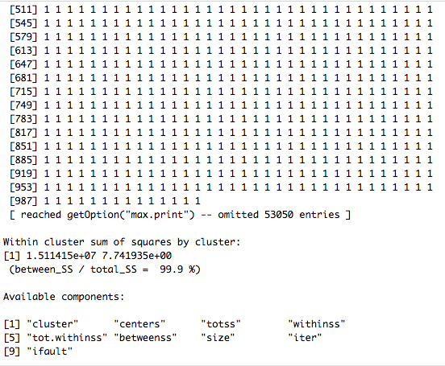
K- Means Clustering
Notes:
1- WHICH KPIS, HOW DO WE CONNECT THE DATABASE, HOW MANY DATABASES WE HAVE?
2- TRAFFIC, REVENUE, SALES?
3- WEEKLY, MONTHLY?
4- ERP SYSTEMS, GOOGLE ANALYTICS, ONLINE SYSTEMS?
5- AFTER TWO WEEKS, 1 MONTH?
6- POWER BI, TABLEAU, EXCEL?

Slide 14
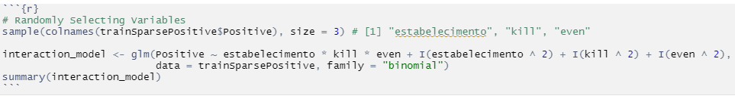
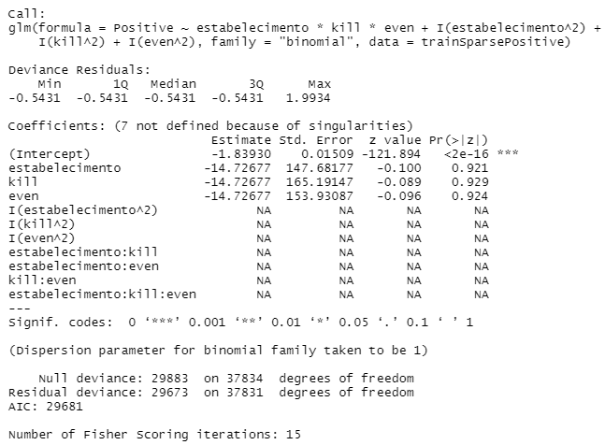
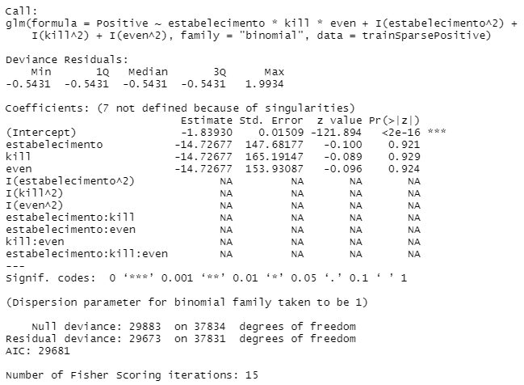
Non - Linear Regression
Notes:
1- WHICH KPIS, HOW DO WE CONNECT THE DATABASE, HOW MANY DATABASES WE HAVE?
2- TRAFFIC, REVENUE, SALES?
3- WEEKLY, MONTHLY?
4- ERP SYSTEMS, GOOGLE ANALYTICS, ONLINE SYSTEMS?
5- AFTER TWO WEEKS, 1 MONTH?
6- POWER BI, TABLEAU, EXCEL?

Slide 15
Conclusion
All the models that we tried were not able to predict with certainty whether a tweets was good or bad except for decision trees and logistic regression for positive tweets.
Notes:
1- WHICH KPIS, HOW DO WE CONNECT THE DATABASE, HOW MANY DATABASES WE HAVE?
2- TRAFFIC, REVENUE, SALES?
3- WEEKLY, MONTHLY?
4- ERP SYSTEMS, GOOGLE ANALYTICS, ONLINE SYSTEMS?
5- AFTER TWO WEEKS, 1 MONTH?
6- POWER BI, TABLEAU, EXCEL?

Slide 16
Non- Linear Regression
QUESTIONS?
Notes:
1- WHICH KPIS, HOW DO WE CONNECT THE DATABASE, HOW MANY DATABASES WE HAVE?
2- TRAFFIC, REVENUE, SALES?
3- WEEKLY, MONTHLY?
4- ERP SYSTEMS, GOOGLE ANALYTICS, ONLINE SYSTEMS?
5- AFTER TWO WEEKS, 1 MONTH?
6- POWER BI, TABLEAU, EXCEL?

Slide 17
THANK YOU
Li Huaikuan | Mariah Bastos | Nicholas Rivera

